Slide 1
Data Communications

Slide 2
The communication media usually have much higher bandwidth.
On the other hand individual users have lesser data to send.
The two communicating stations do not utilize the full capacity of a data link.
.

Slide 3
Multiplexing is the set of techniques that allow the simultaneous transmission of multiple signals across a single data link.
Allows several transmission sources to share a larger transmission capacity.
.

Slide 4
Multiplexer : Combines (multiplexes) data from the n input lines and transmits over a higher-capacity data link.
Demultiplexer : Accepts the multiplexed data stream, separates (demultiplexes) the data according to channel, and delivers data to the appropriate output lines.
Link
channel
.

Slide 5
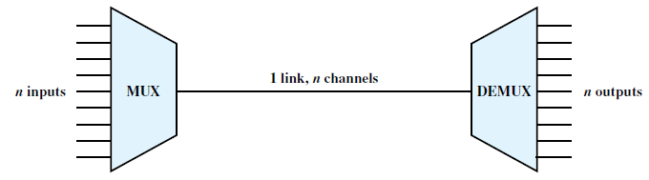
Figure 8.1 Multiplexing
.

Slide 6
Three types of multiplexing techniques.
Frequency division multiplexing (FDM)
  The most heavily used
  Familiar to anyone who has ever used a radio or television set.
Time division multiplexing (TDM)
  known as synchronous TDM.
  Commonly used for multiplexing digitized voice streams and data streams.
Statistical TDM.
  To improve on the efficiency of synchronous TDM by adding complexity to the multiplexer.
  Also known as asynchronous TDM, and intelligent TDM.
.

Slide 7
FREQUENCY DIVISION MULTIPLEXING (FDM)
  Can be used with analog signals.
  A number of signals are carried simultaneously on the same medium by allocating to each signal a different frequency band.
  Modulation equipment is needed to move each signal to the required frequency band, and
  Multiplexing equipment is needed to combine the modulated signals
.

Slide 8
FREQUENCY DIVISION MULTIPLEXING (FDM)
FDM is possible when the useful bandwidth of the transmission medium exceeds the required bandwidth of signals to be transmitted.
A number of signals can be carried simultaneously if each signal is modulated onto a different carrier frequency and the carrier frequencies are sufficiently separated that the bandwidths of the signals do not significantly overlap.
.

Slide 9
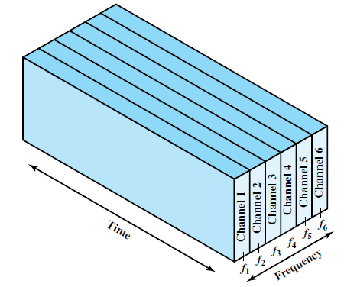
FREQUENCY DIVISION MULTIPLEXING
(a) Frequency division multiplexing
Six signal sources are fed into a multiplexer, which modulates each signal onto a different frequency
Each modulated signal requires a certain bandwidth centered on its carrier frequency, referred to as a channel.
To prevent interference, the channels are separated by guard bands, which are unused portions of the spectrum.
.

Slide 10
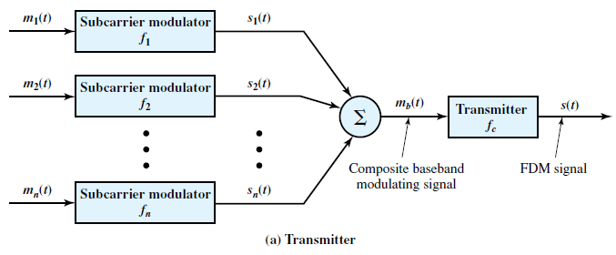
FREQUENCY DIVISION MULTIPLEXING
Figure 8.4 FDM System
Signals [ m_{i}(t), i = 1, n ] are to be multiplexed onto the same transmission medium.
Each signal m_{i}(t) is modulated onto a carrier ; because multiple carriers are to be used, each is referred to as a subcarrier. Any type of modulation may be used.
The resulting analog, modulated signals are then summed to produce a composite baseband signal m_{b}(t)
.

Slide 11
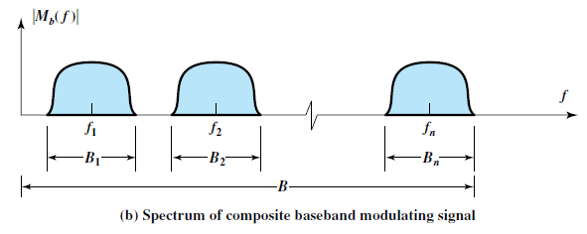
FREQUENCY DIVISION MULTIPLEXING
Figure 8.4 FDM System
The spectrum of signal m_{i}(t) is shifted to be centered on f_{i}
f_{i} must be chosen so that the bandwidths of the various signals do not significantly overlap.
.

Slide 12
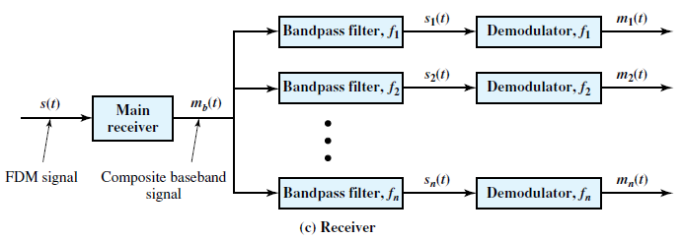
FREQUENCY DIVISION MULTIPLEXING
Figure 8.4 FDM System
The FDM signal s(t) has a total bandwidth B, where .
At the receiving end, the FDM signal is demodulated to retrieve m_{b}(t) which is then passed through n bandpass filters, each filter centered on f_{i} and having a bandwidth B_{i}, for 1<= i <= n
.

Slide 13

Multiplexing Process
Each source generates a signal of a similar frequency range.
Inside the multiplexer, these similar signals modulate different carrier frequencies ( f1, f2, and f3).
The resulting modulated signals are then combined into a single composite signal that is sent out over a media link.
.

Slide 14

Demultiplexing Process
The demultiplexer uses a series of filters to decompose the multiplexed signal into its constituent component signals.
The individual signals are then passed to a demodulator that separates them from their carriers and passes them to the output lines.
.

Slide 15
Assume that a voice channel occupies a bandwidth of 4 kHz. We need to combine three voice channels into a link with a bandwidth of 12 kHz, from 20 to 32 kHz. Show the configuration, using the frequency domain. Assume there are no guard bands.
.

Slide 16
Assume that a voice channel occupies a bandwidth of 4 kHz. We need to combine three voice channels into a link with a bandwidth of 12 kHz, from 20 to 32 kHz. Show the configuration, using the frequency domain. Assume there are no guard bands.
Solution
modulate each of the three voice channels to a different bandwidth.
Use the 20- to 24-kHz bandwidth for the first channel, the 24- to 28-kHz bandwidth for the second channel, and the 28- to 32-kHz bandwidth for the third one. Then we combine them .
.

Slide 17

.

Slide 18
Five channels, each with a 100-kHz bandwidth, are to be multiplexed together. What is the minimum bandwidth of the link if there is a need for a guard band of 10 kHz between the channels to prevent interference?
.

Slide 19

Five channels, each with a 100-kHz bandwidth, are to be multiplexed together. What is the minimum bandwidth of the link if there is a need for a guard band of 10 kHz between the channels to prevent interference?
Solution
For five channels, we need at least four guard bands. This means that the required bandwidth is at least
5 × 100 + 4 × 10 = 540 kHz,
.

Slide 20
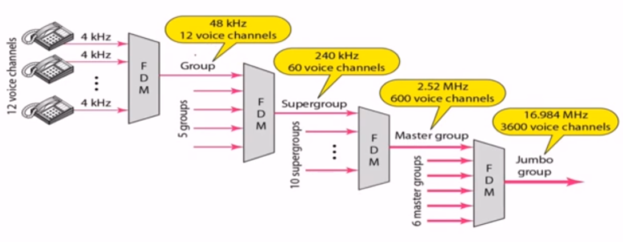
.

Slide 21
Wavelength Division Multiplexing
This is a form of FDM but is commonly called wavelength division multiplexing (WDM).
Used to increase the capacity of optical fiber.
Number of light sources of used with a different wavelength.
.

Slide 22
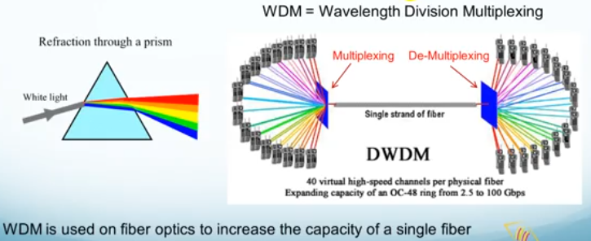
Wavelength Division Multiplexing
.

Slide 23
Wavelength Division Multiplexing
WDM system has the same general architecture as other FDM systems.
A number of sources generate a laser beam at different wavelengths.
These are sent to a multiplexer, which consolidates the sources for transmission over a single fiber line.
At receiver side, demultiplexer separates different wavelength and gives it to different receiver.
.

